Slide 1
In Claude Cowork
Notes:
https://github.com/jackcohen10/managergpt-marketplace

Slide 2
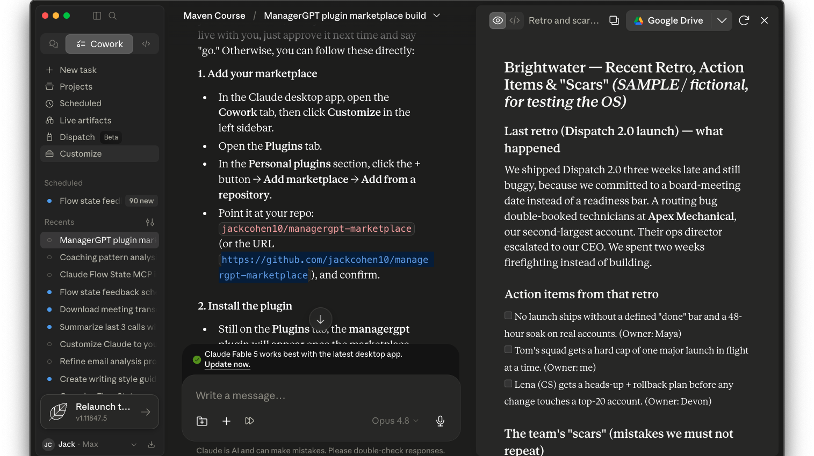
Notes:
https://github.com/jackcohen10/managergpt-marketplace

Slide 3
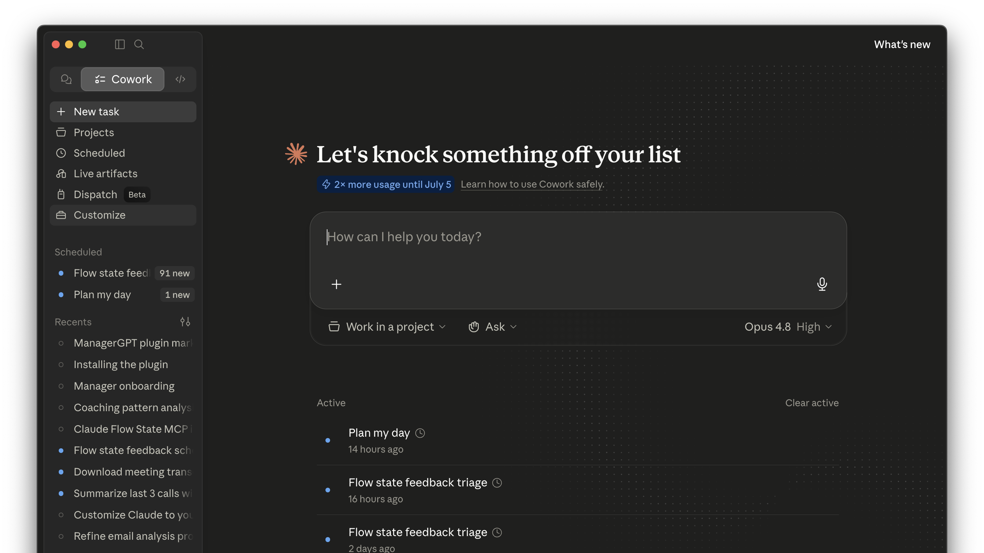
Notes:
https://github.com/jackcohen10/managergpt-marketplace

Slide 4
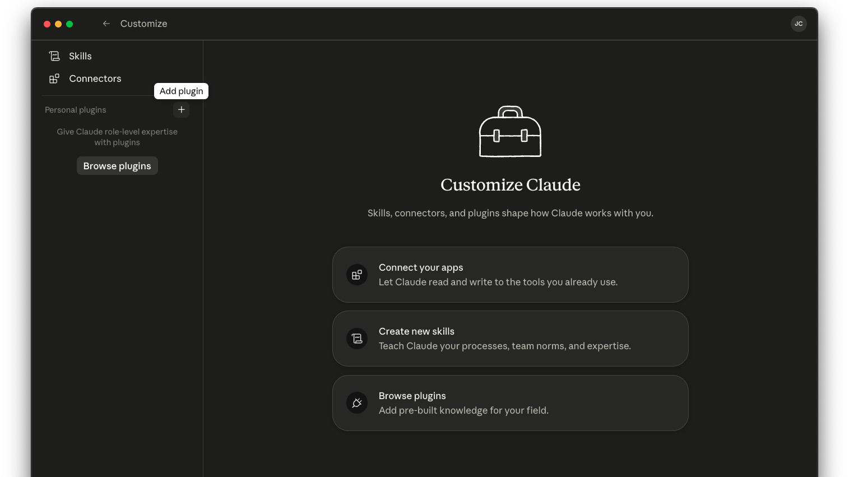

Slide 5
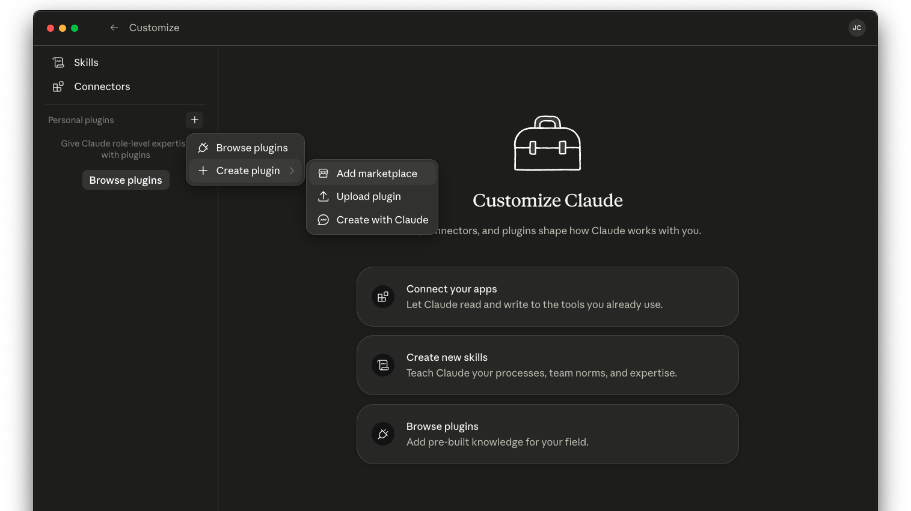

Slide 6
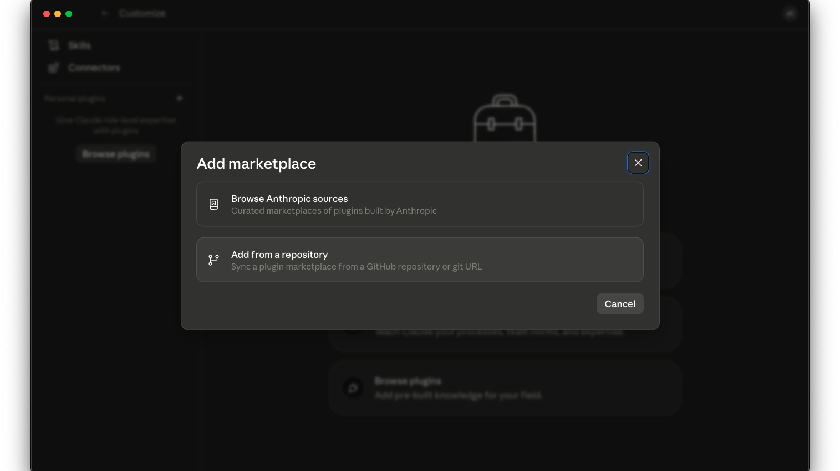

Slide 7
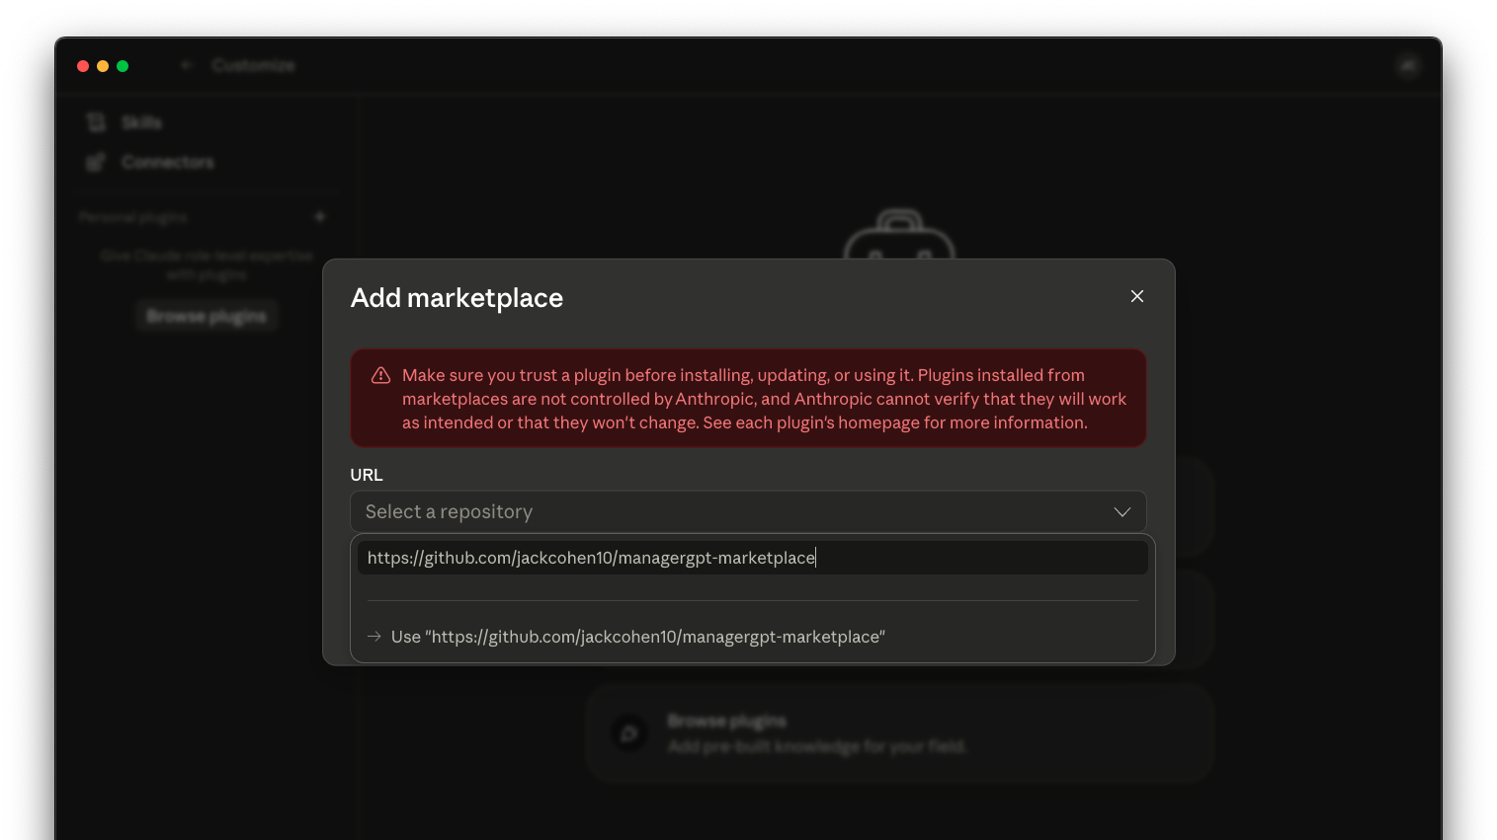
Copy/paste: https://github.com/jackcohen10/managergpt-marketplace
Notes:
https://github.com/jackcohen10/managergpt-marketplace

Slide 8
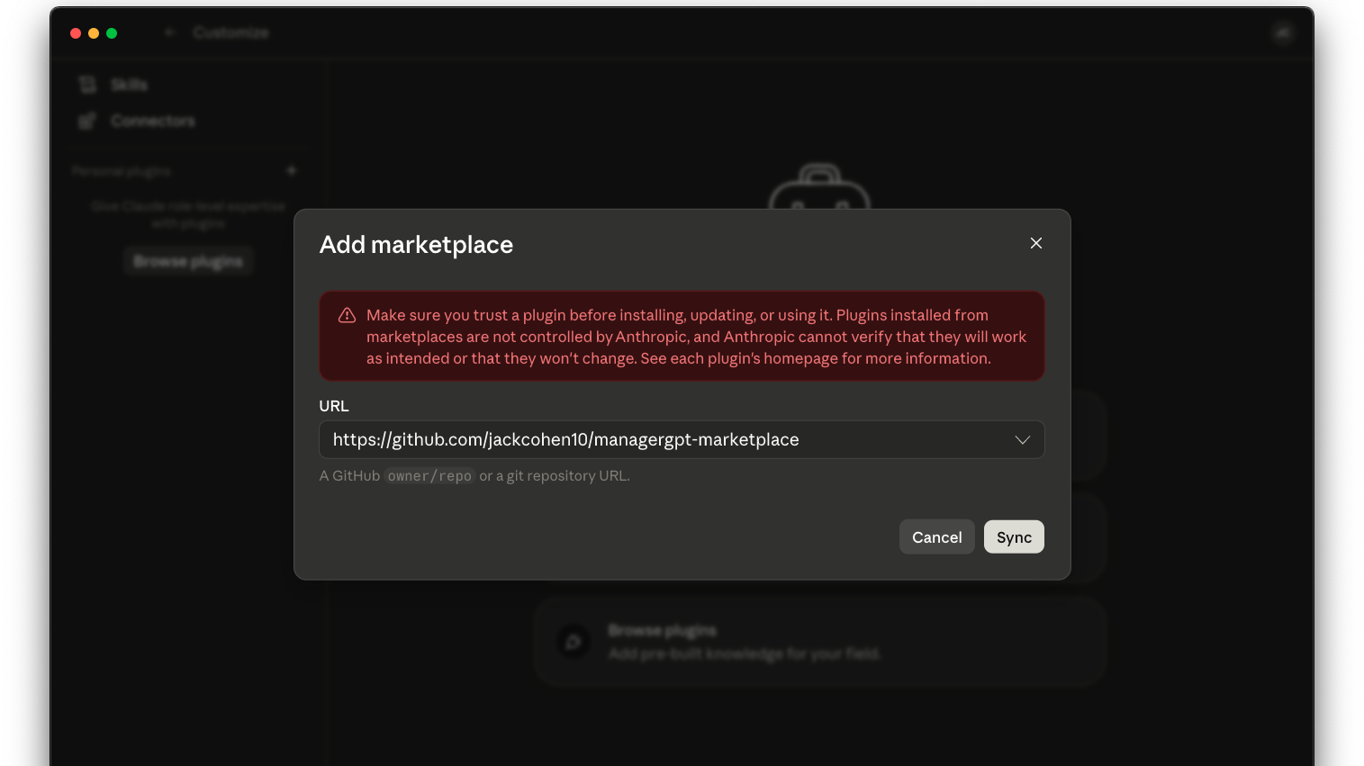

Slide 9
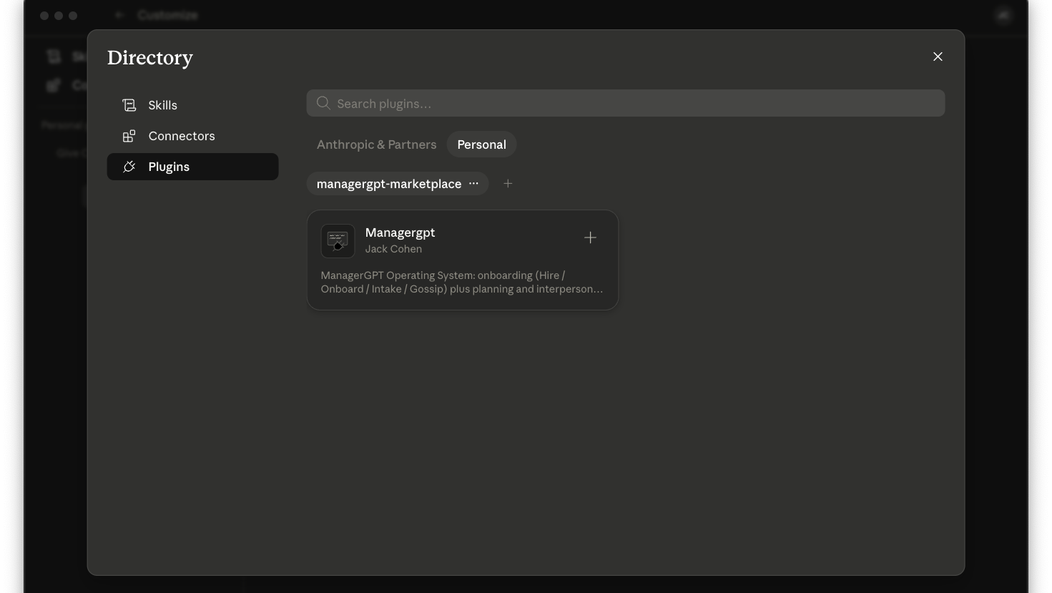
It’s installed successfully when you see this

Slide 10
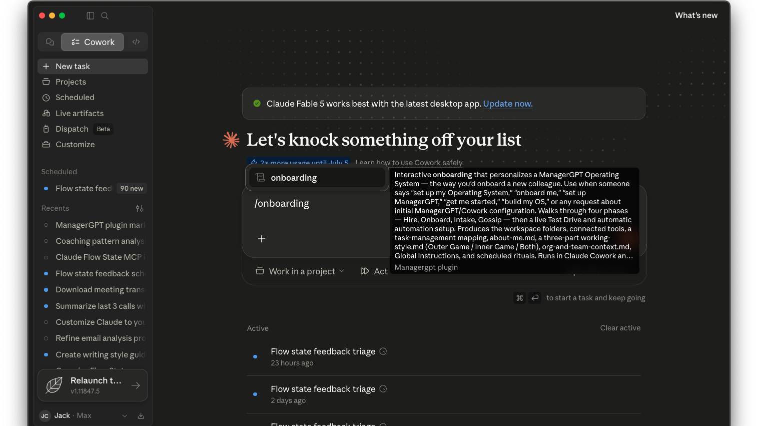

Slide 11
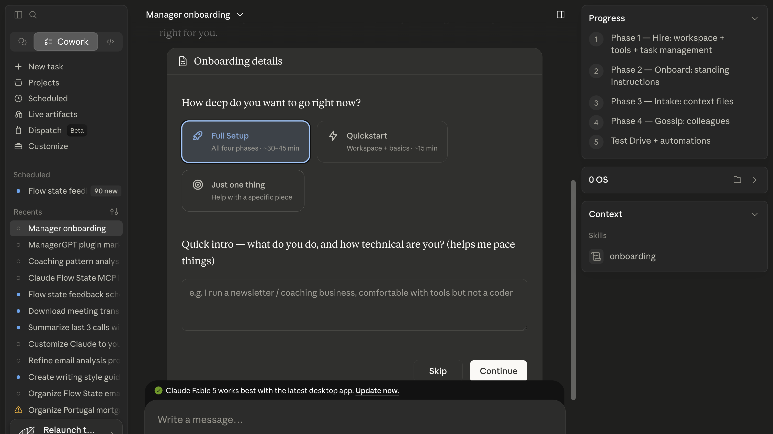
Choose Full Setup

Slide 12
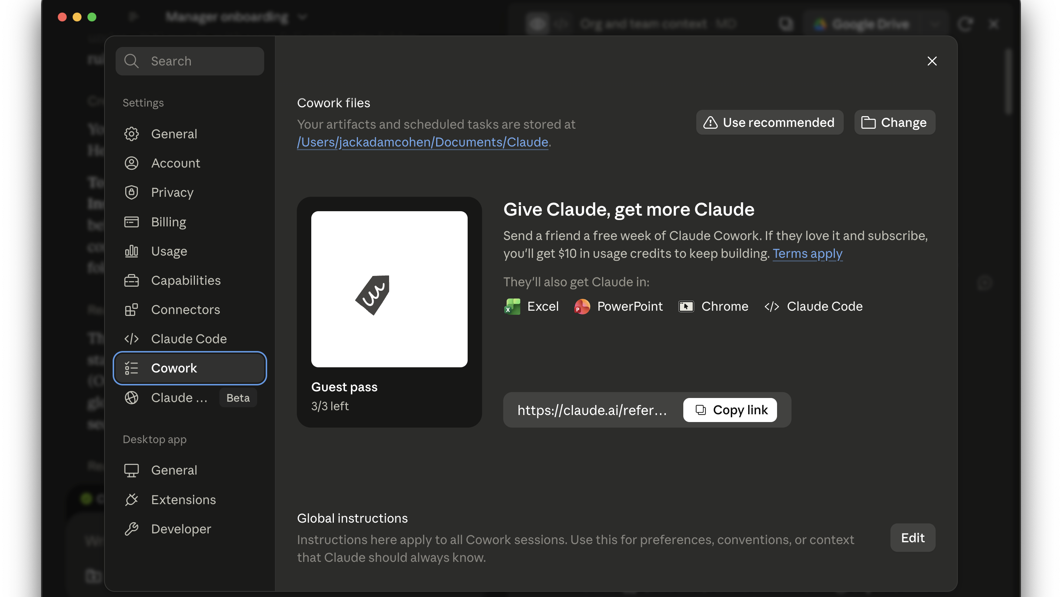
Click Cowork, then Edit (you might need to scroll down to see Edit

Slide 13
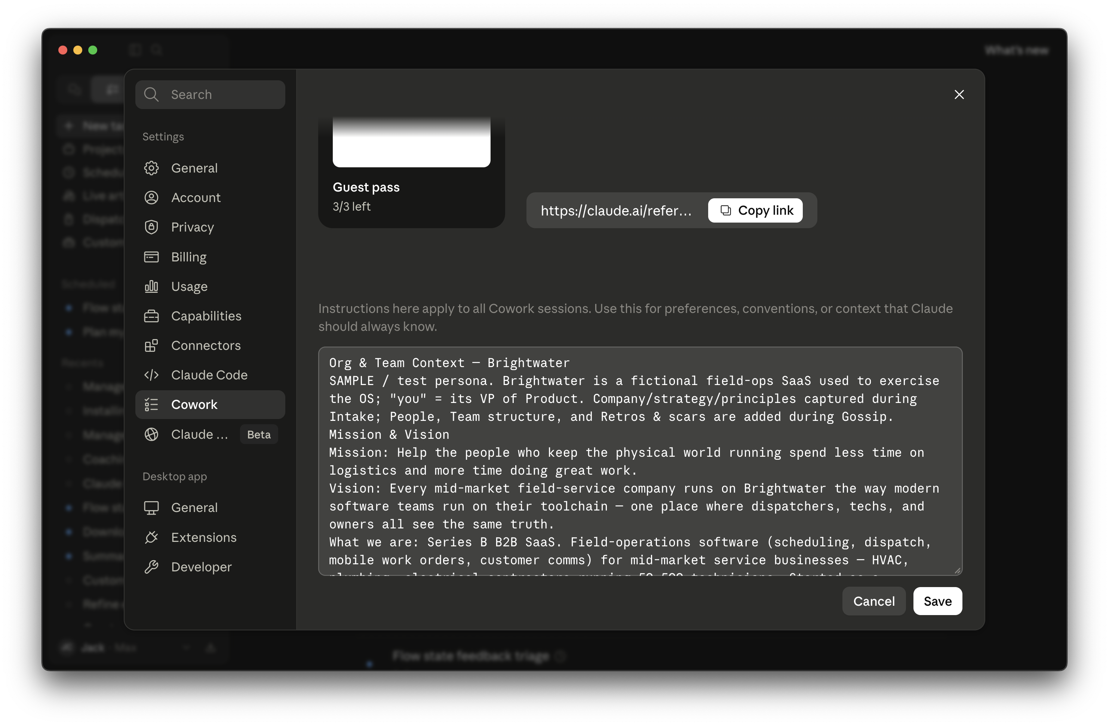
(Scroll down and) Click Save

Slide 14
In Codex
Notes:
https://github.com/jackcohen10/managergpt-marketplace

Slide 15
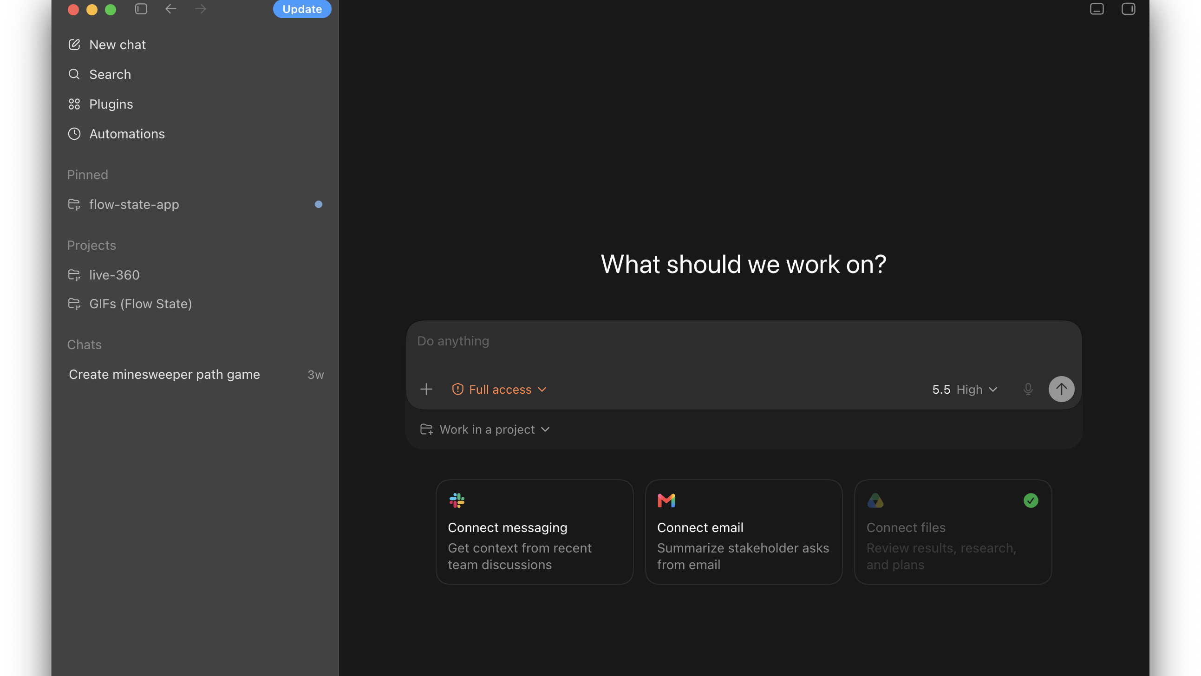

Slide 16
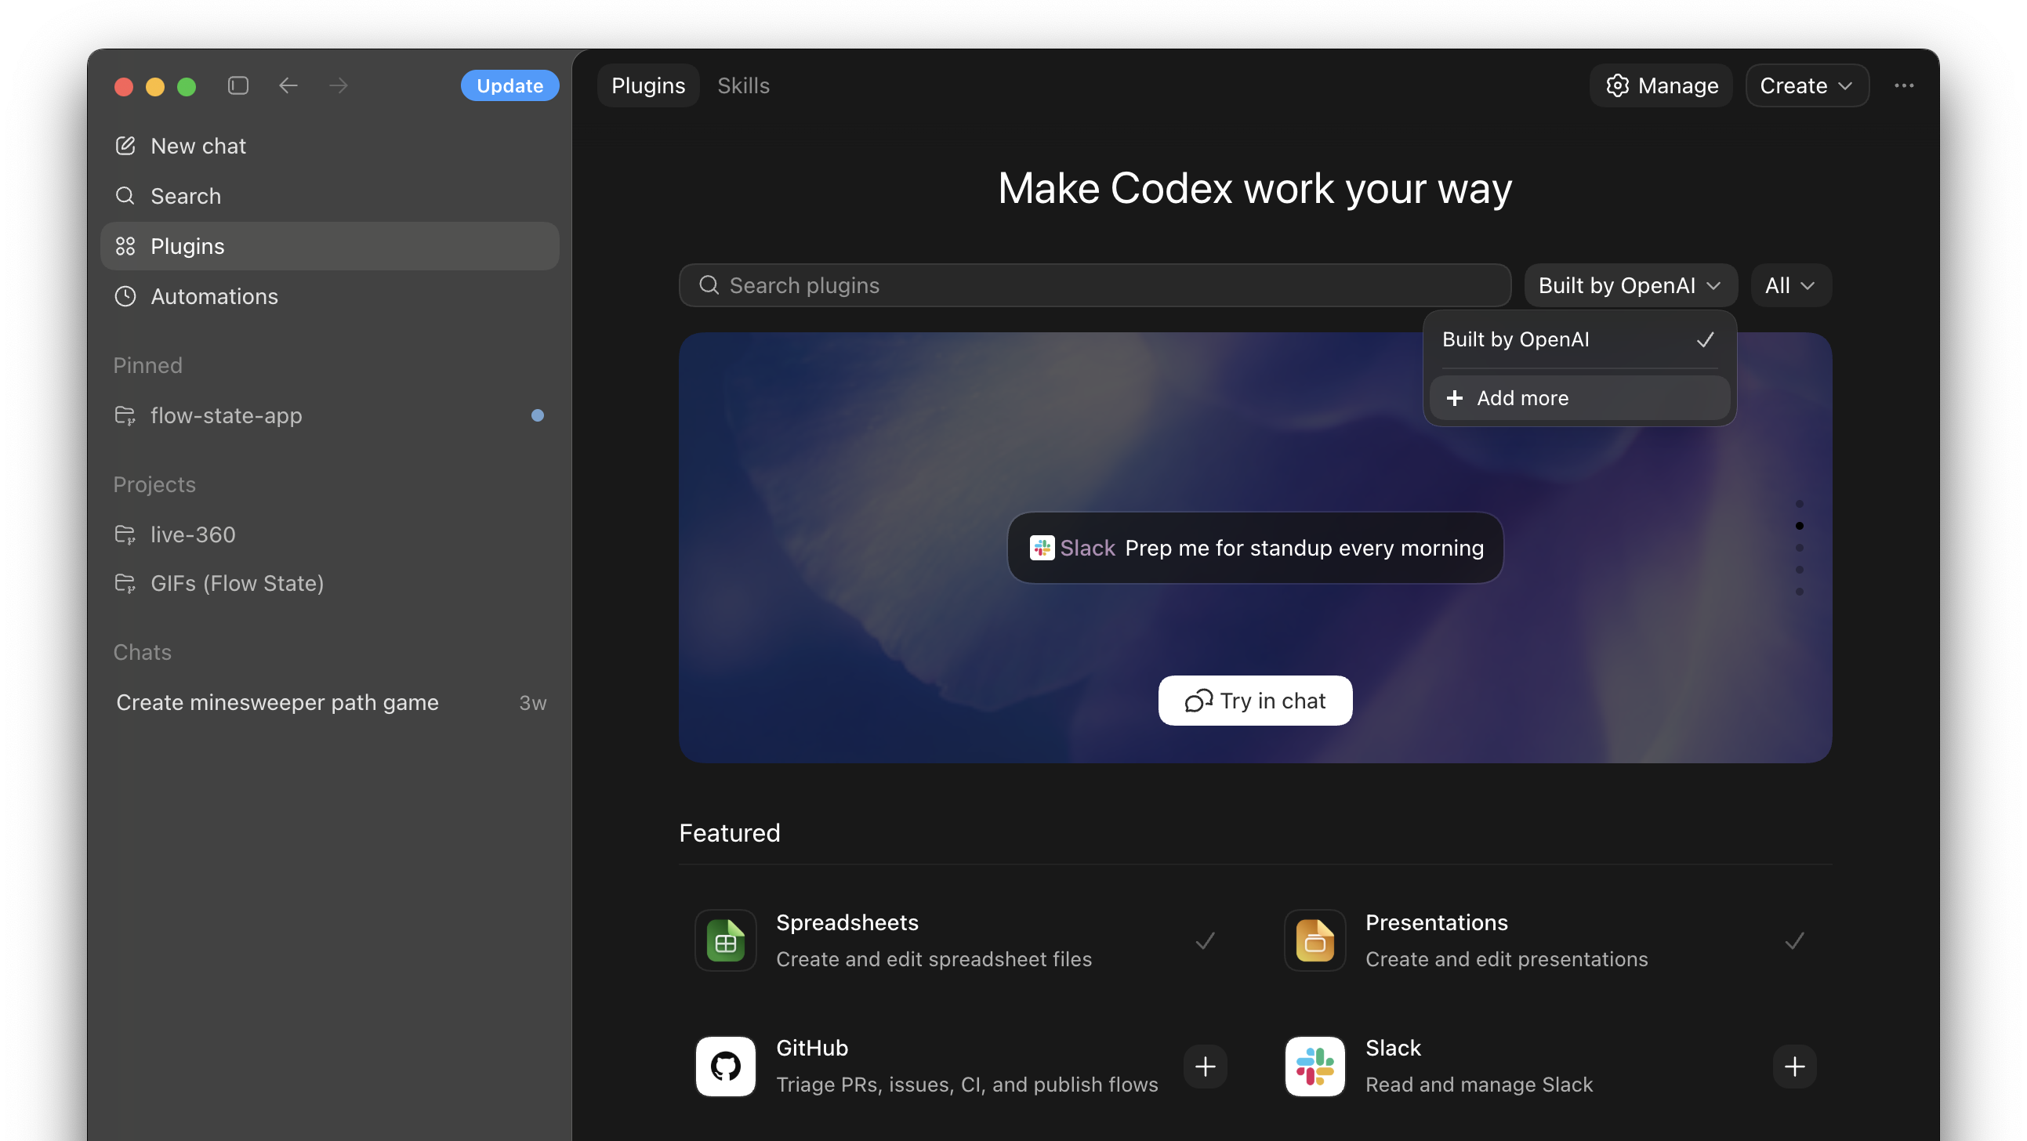

Slide 17
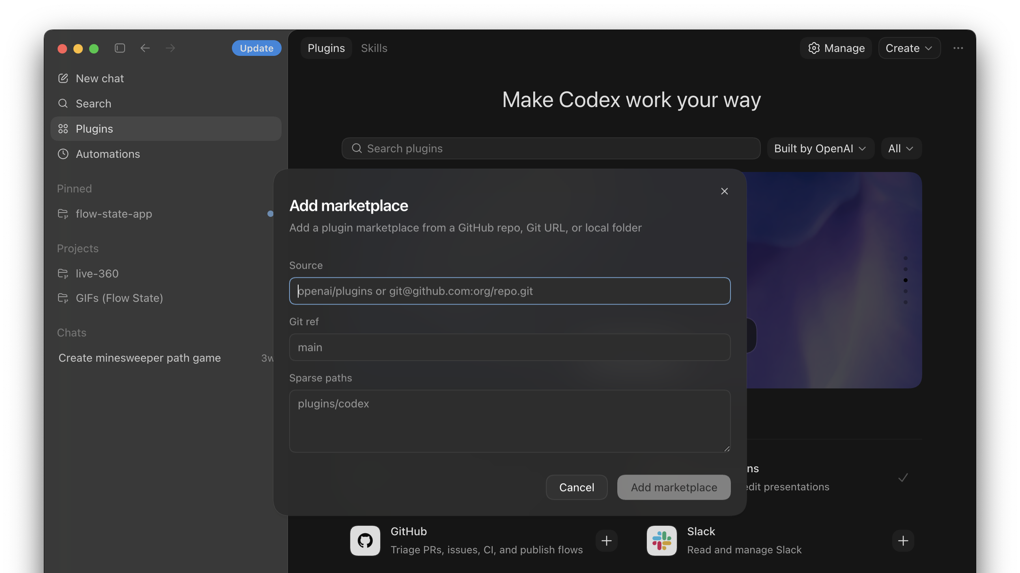

Slide 18
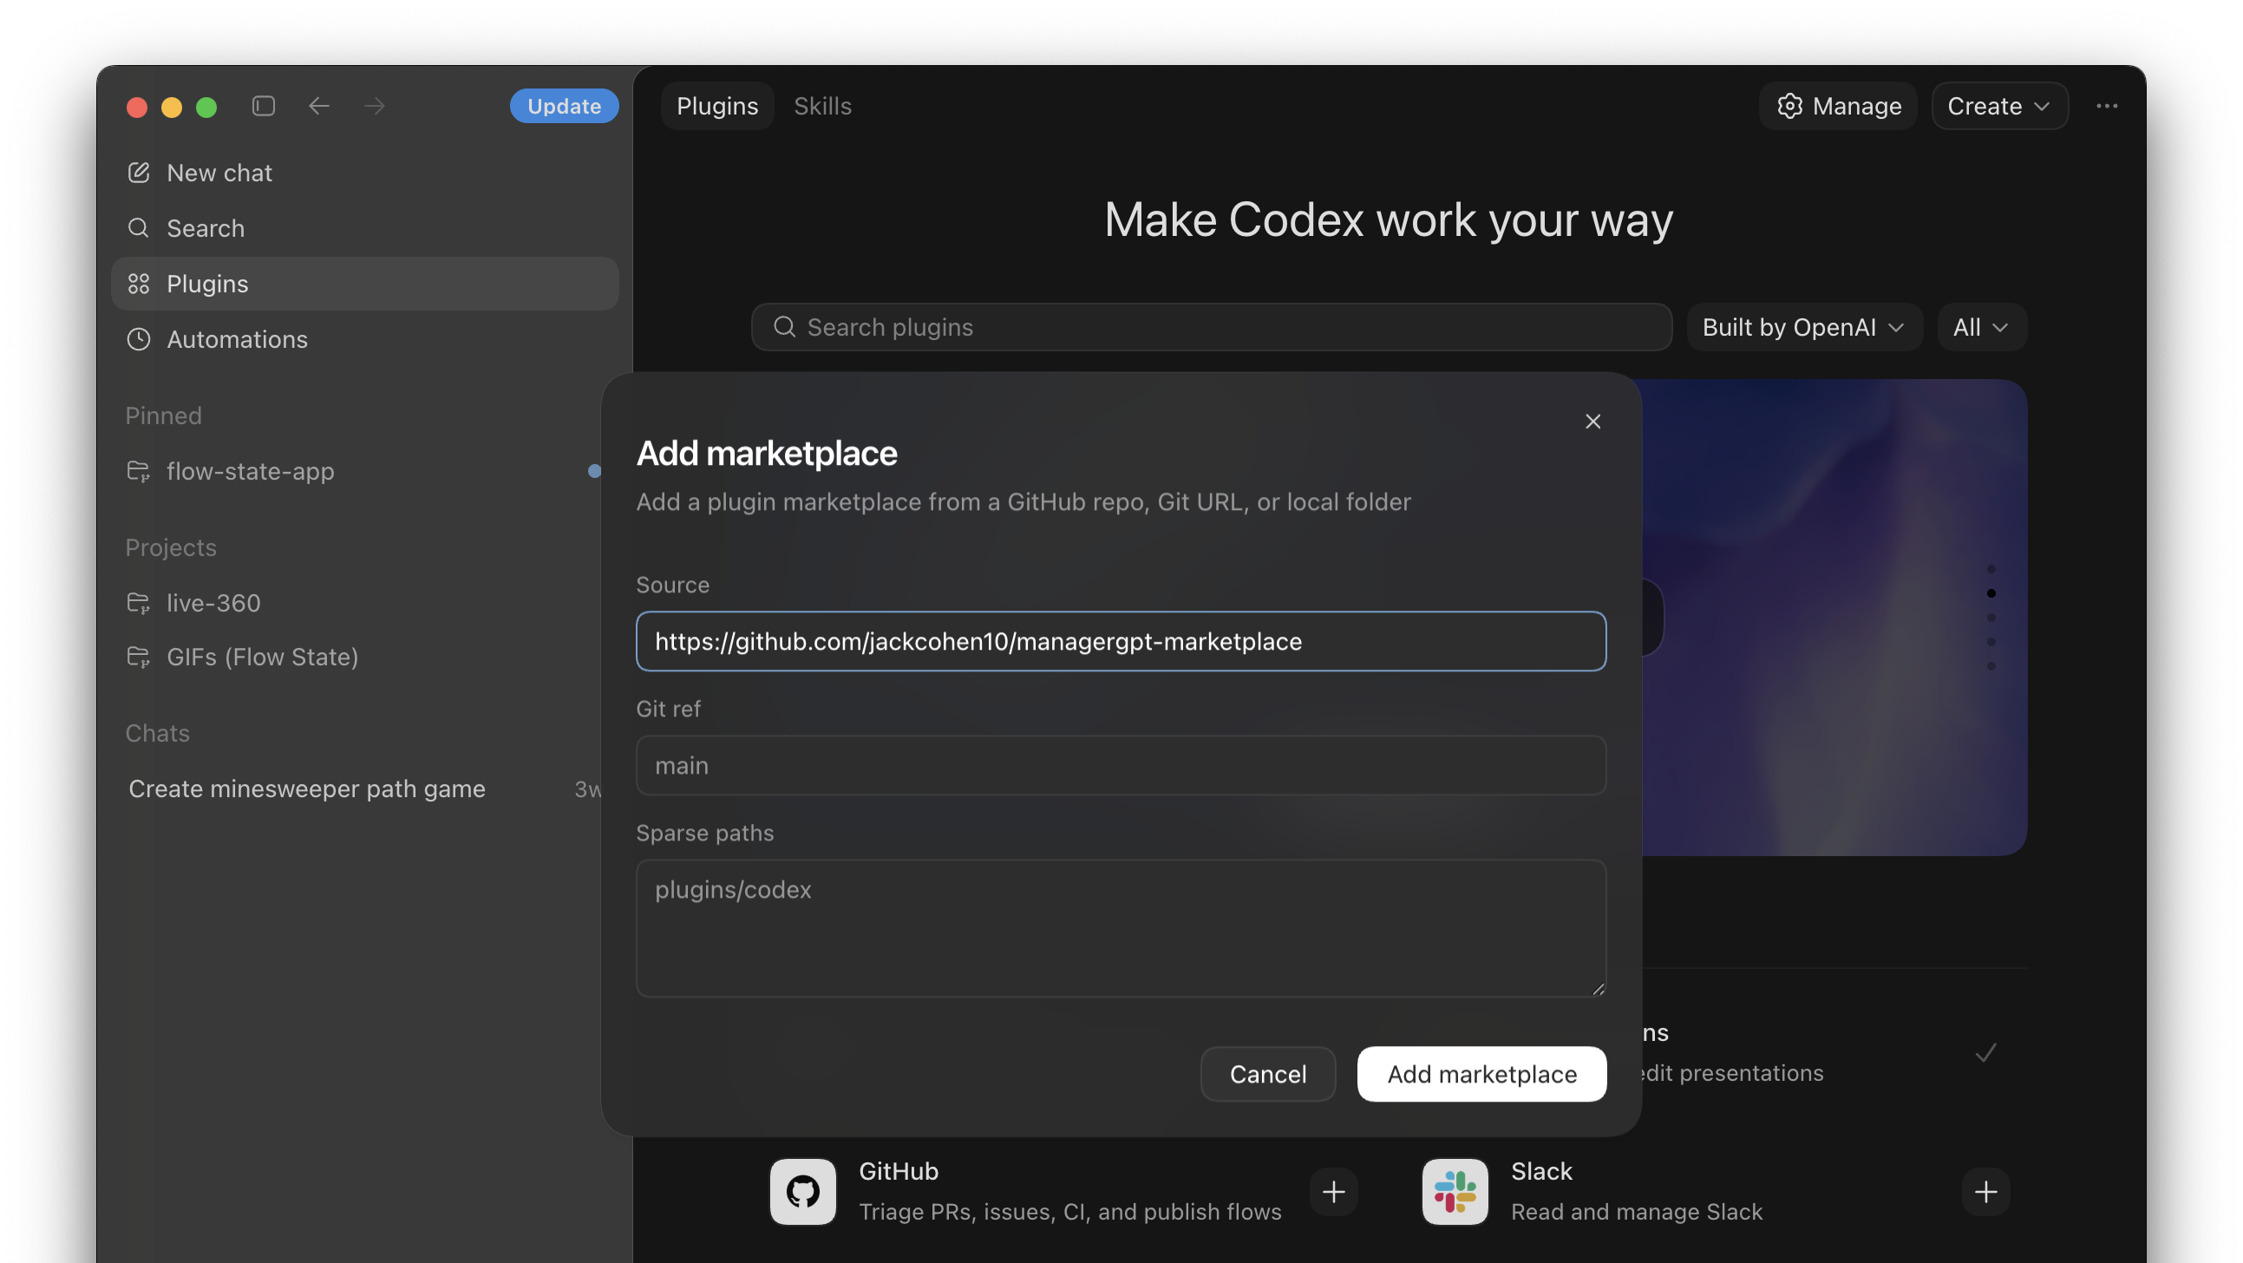

Slide 19
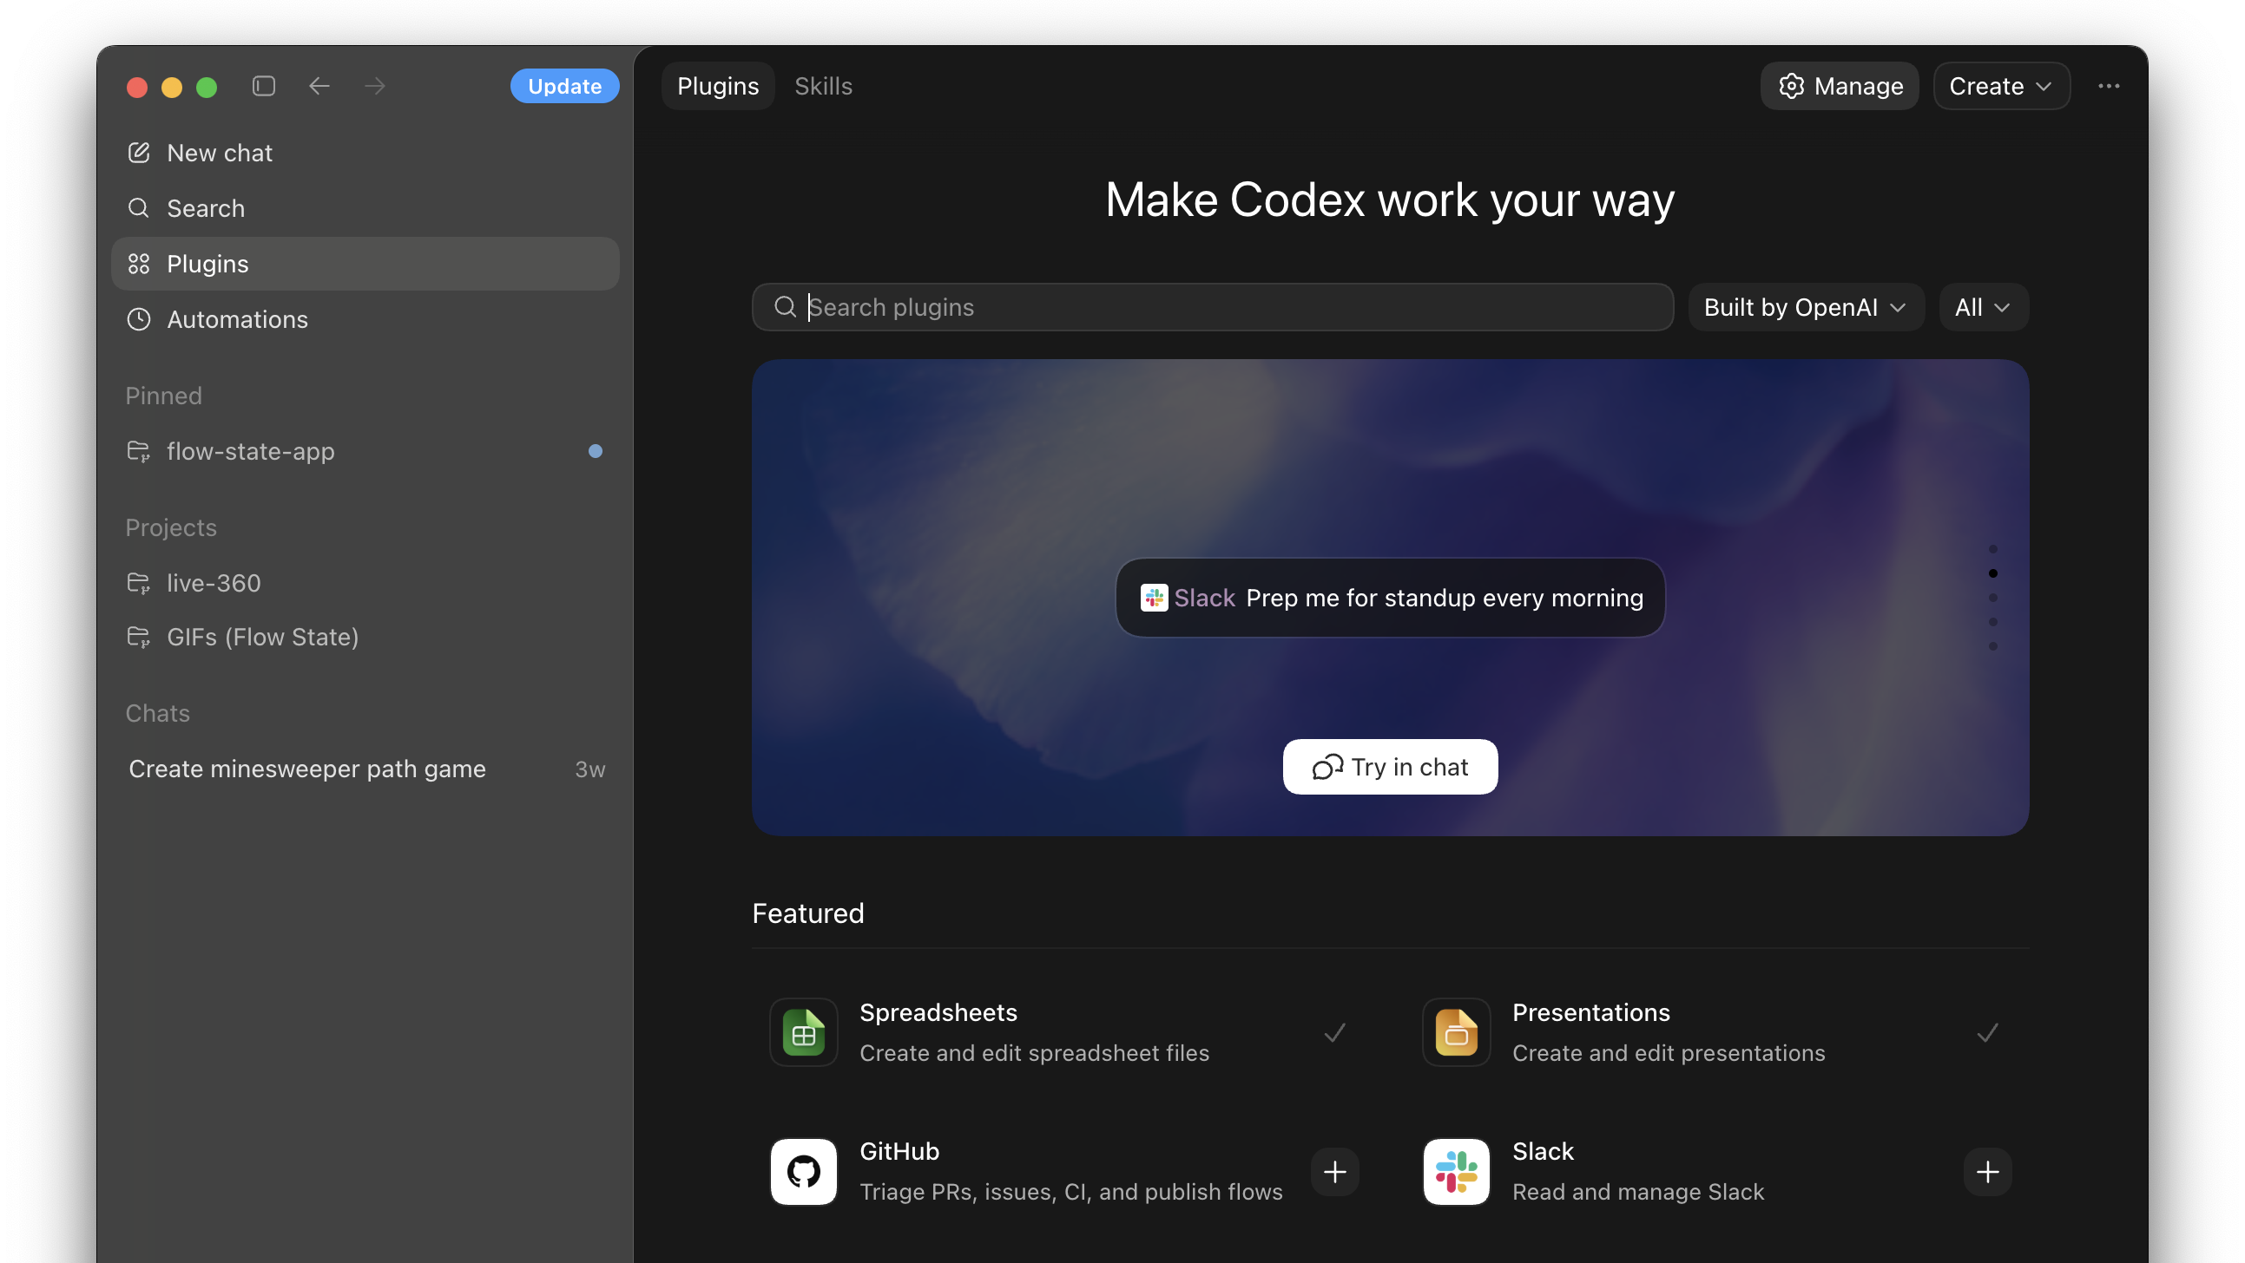

Slide 20
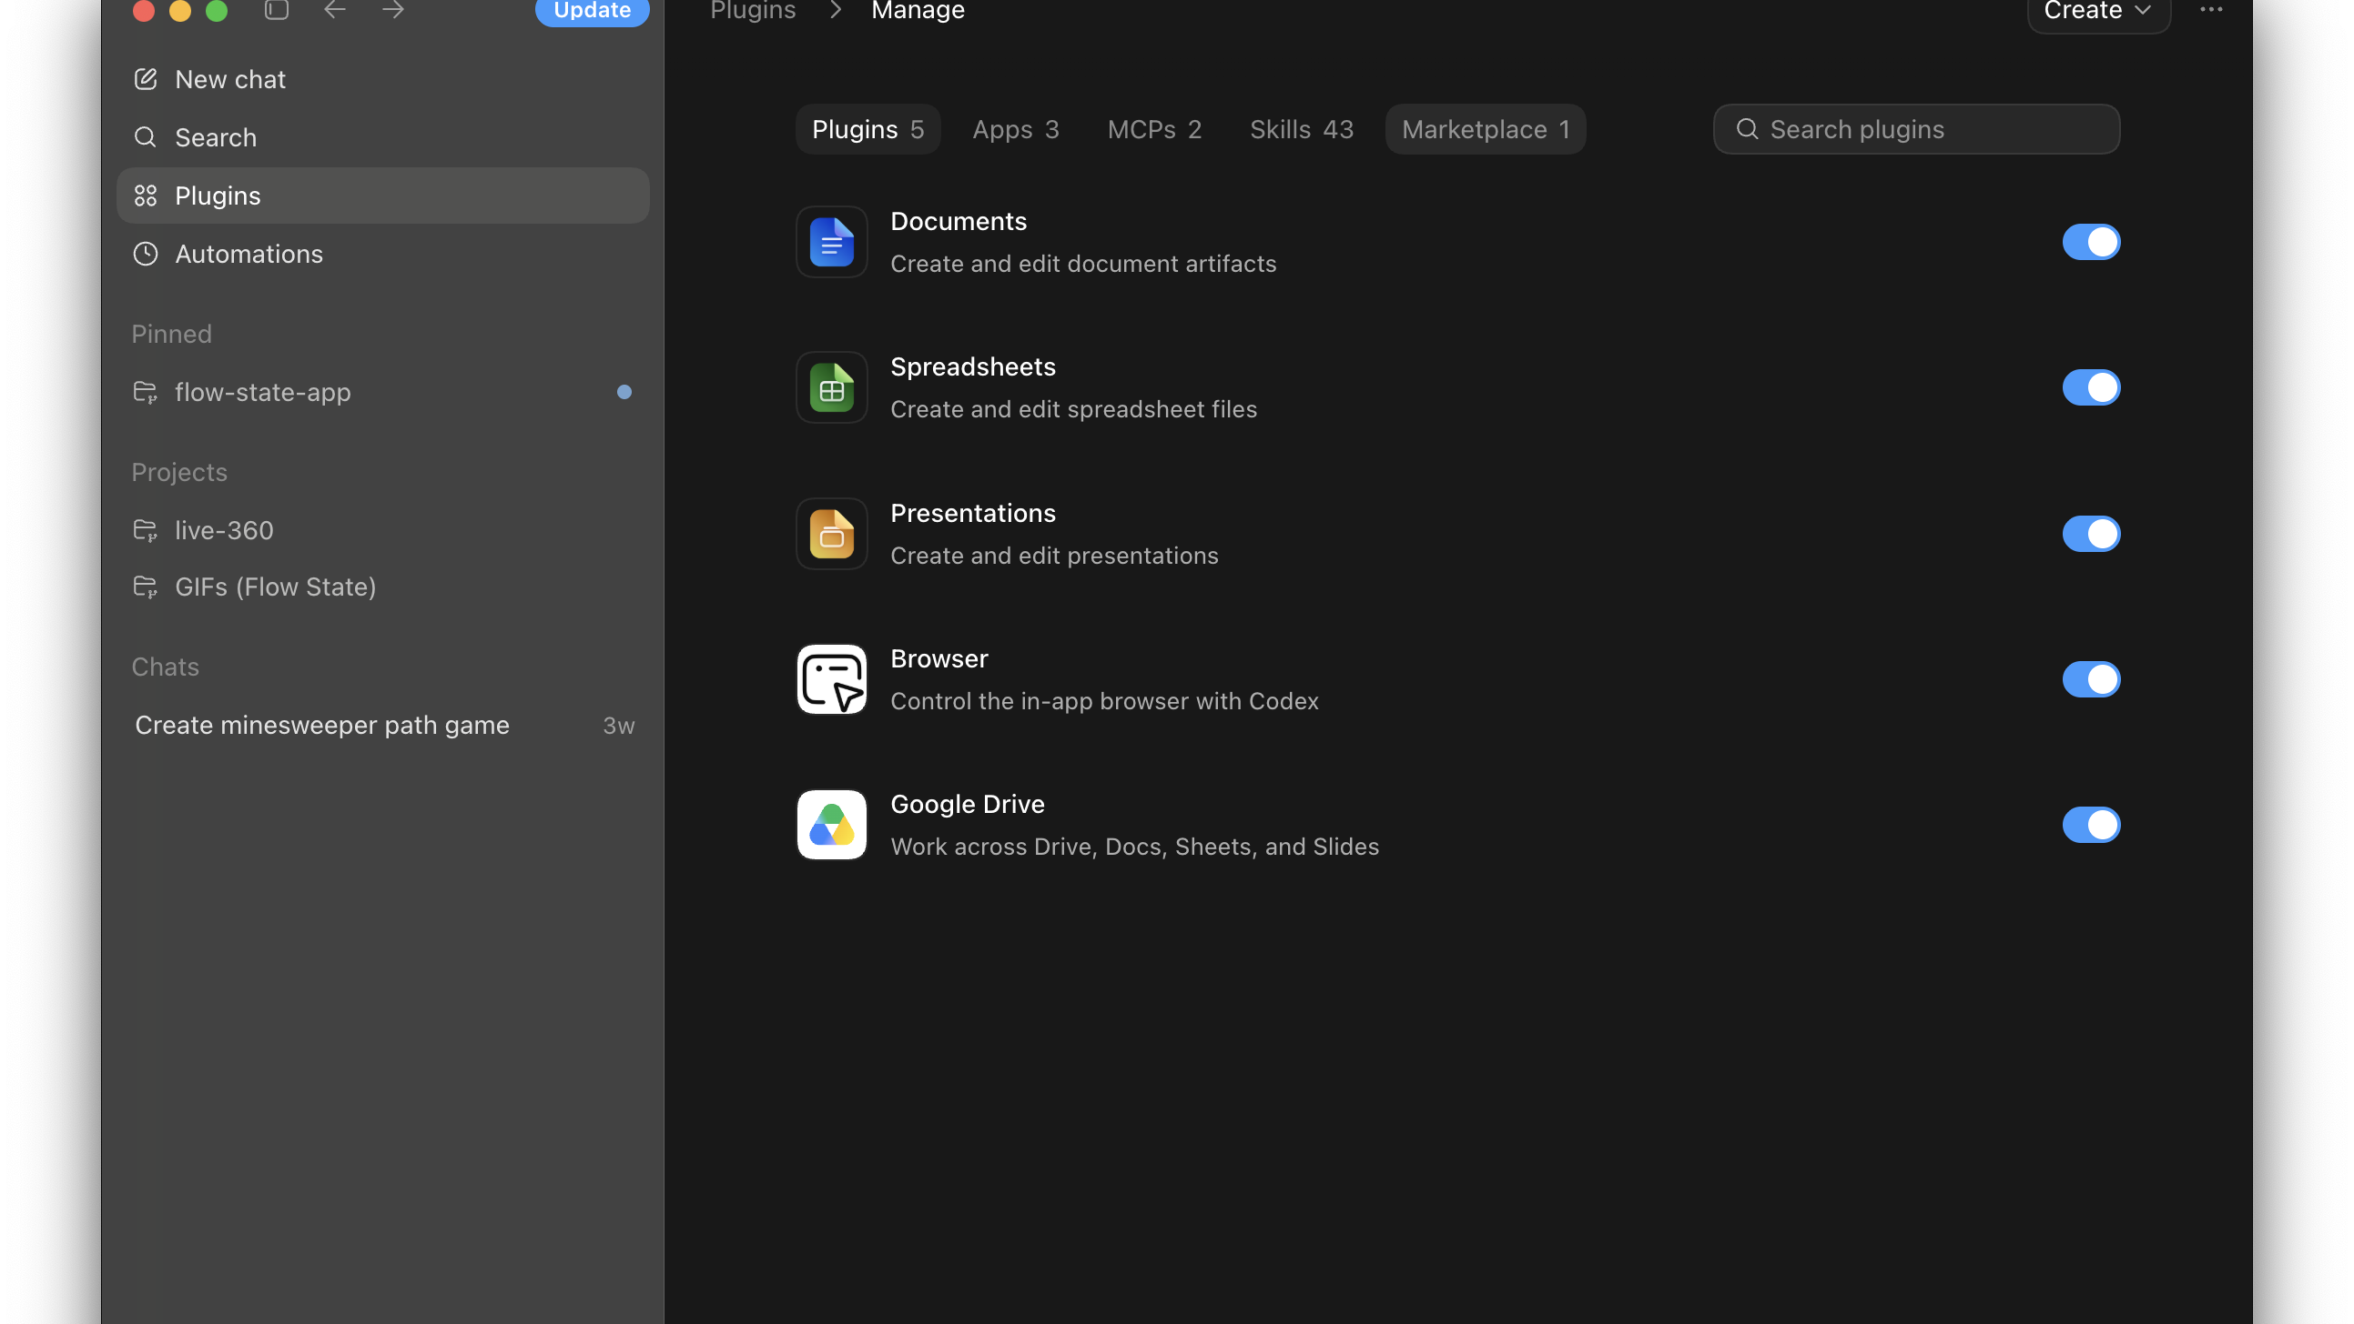

Slide 21
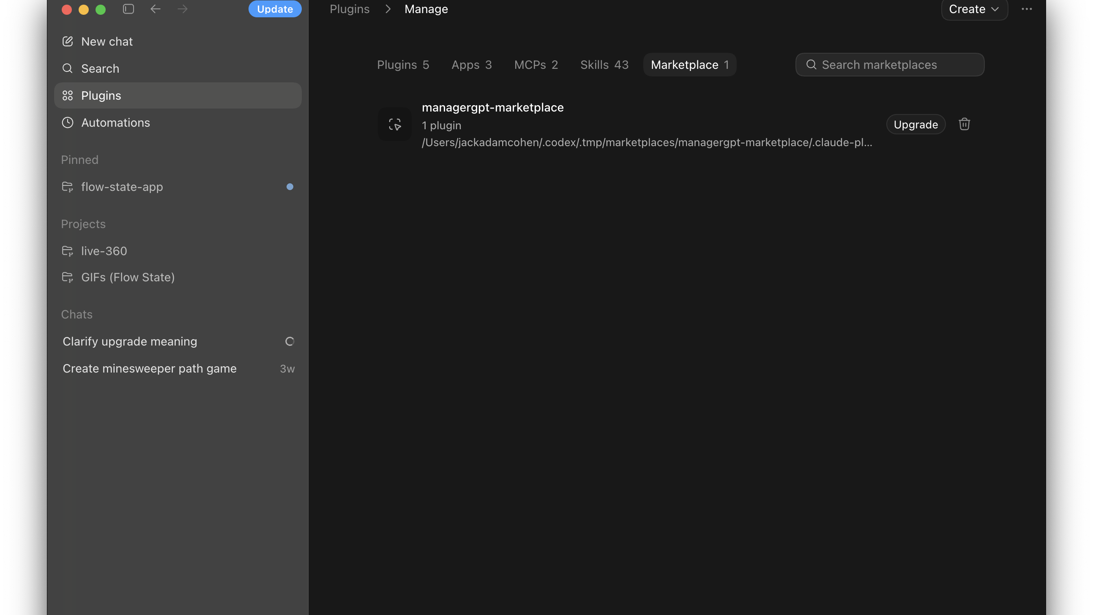
Success!

Slide 22
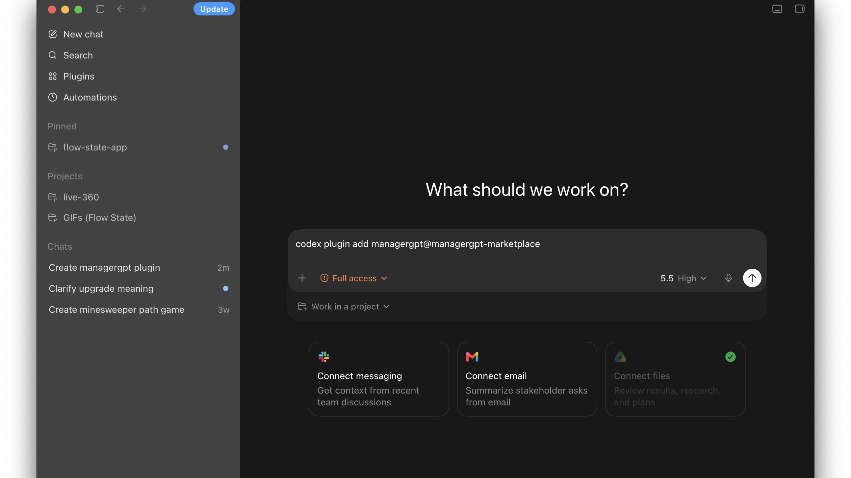
Notes:
codex plugin add managergpt@managergpt-marketplace

Slide 23
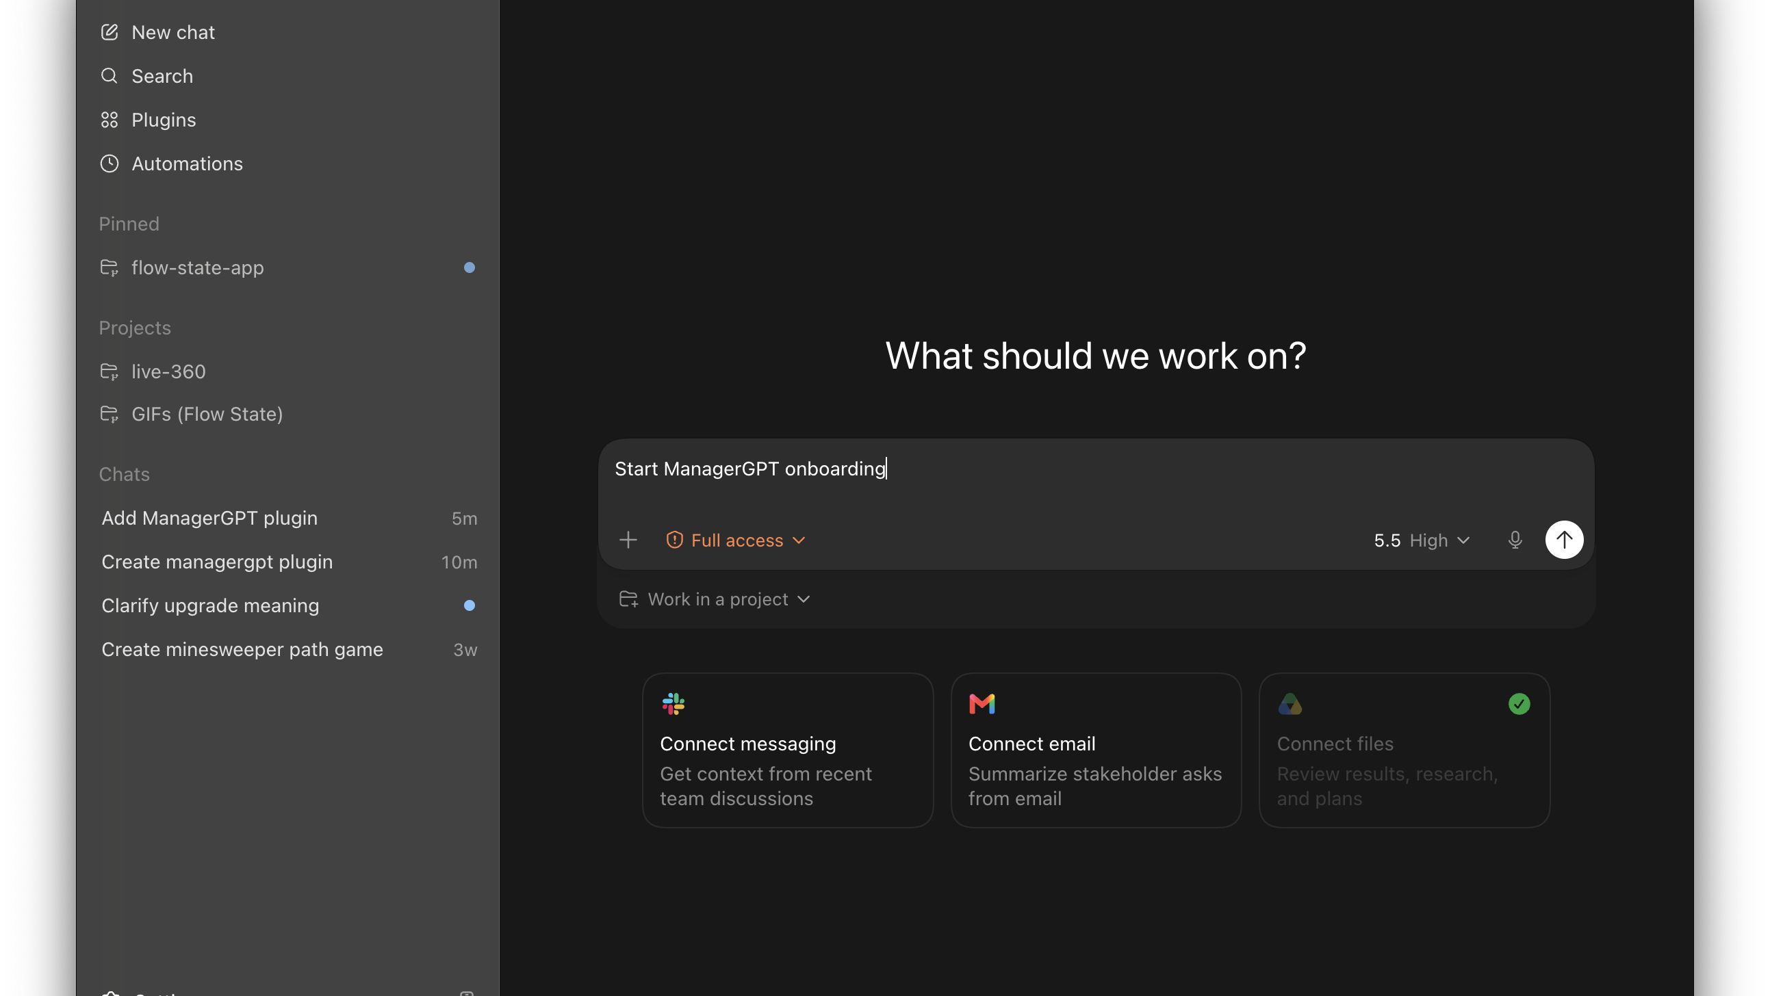

Slide 24
